Slide 1
Fionda Scheduler

Slide 2
Local Inference of LLM
22/07/2026
Santarsiero Andrea, Stanghellini Giovanni
01/11

Slide 3
Vanilla scheduler
22/07/2026
Santarsiero Andrea, Stanghellini Giovanni
02/11

Slide 4
Fionda scheduler
22/07/2026
Santarsiero Andrea, Stanghellini Giovanni
03/11

Slide 5
Benchmarking LLM inference
22/07/2026
Santarsiero Andrea, Stanghellini Giovanni
04/11

Slide 6
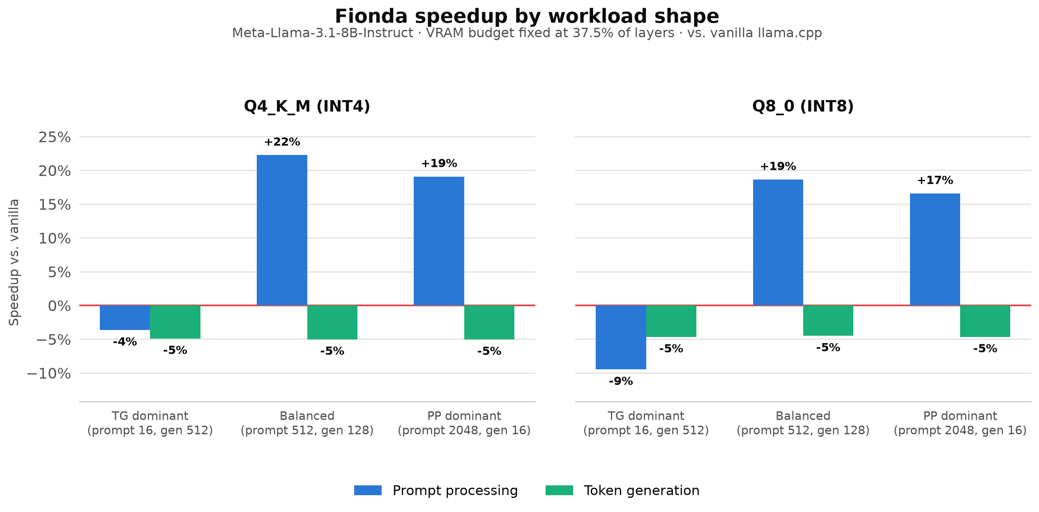
Llama 3.1 prompt benchmark
22/07/2026
Santarsiero Andrea, Stanghellini Giovanni
05/11

Slide 7
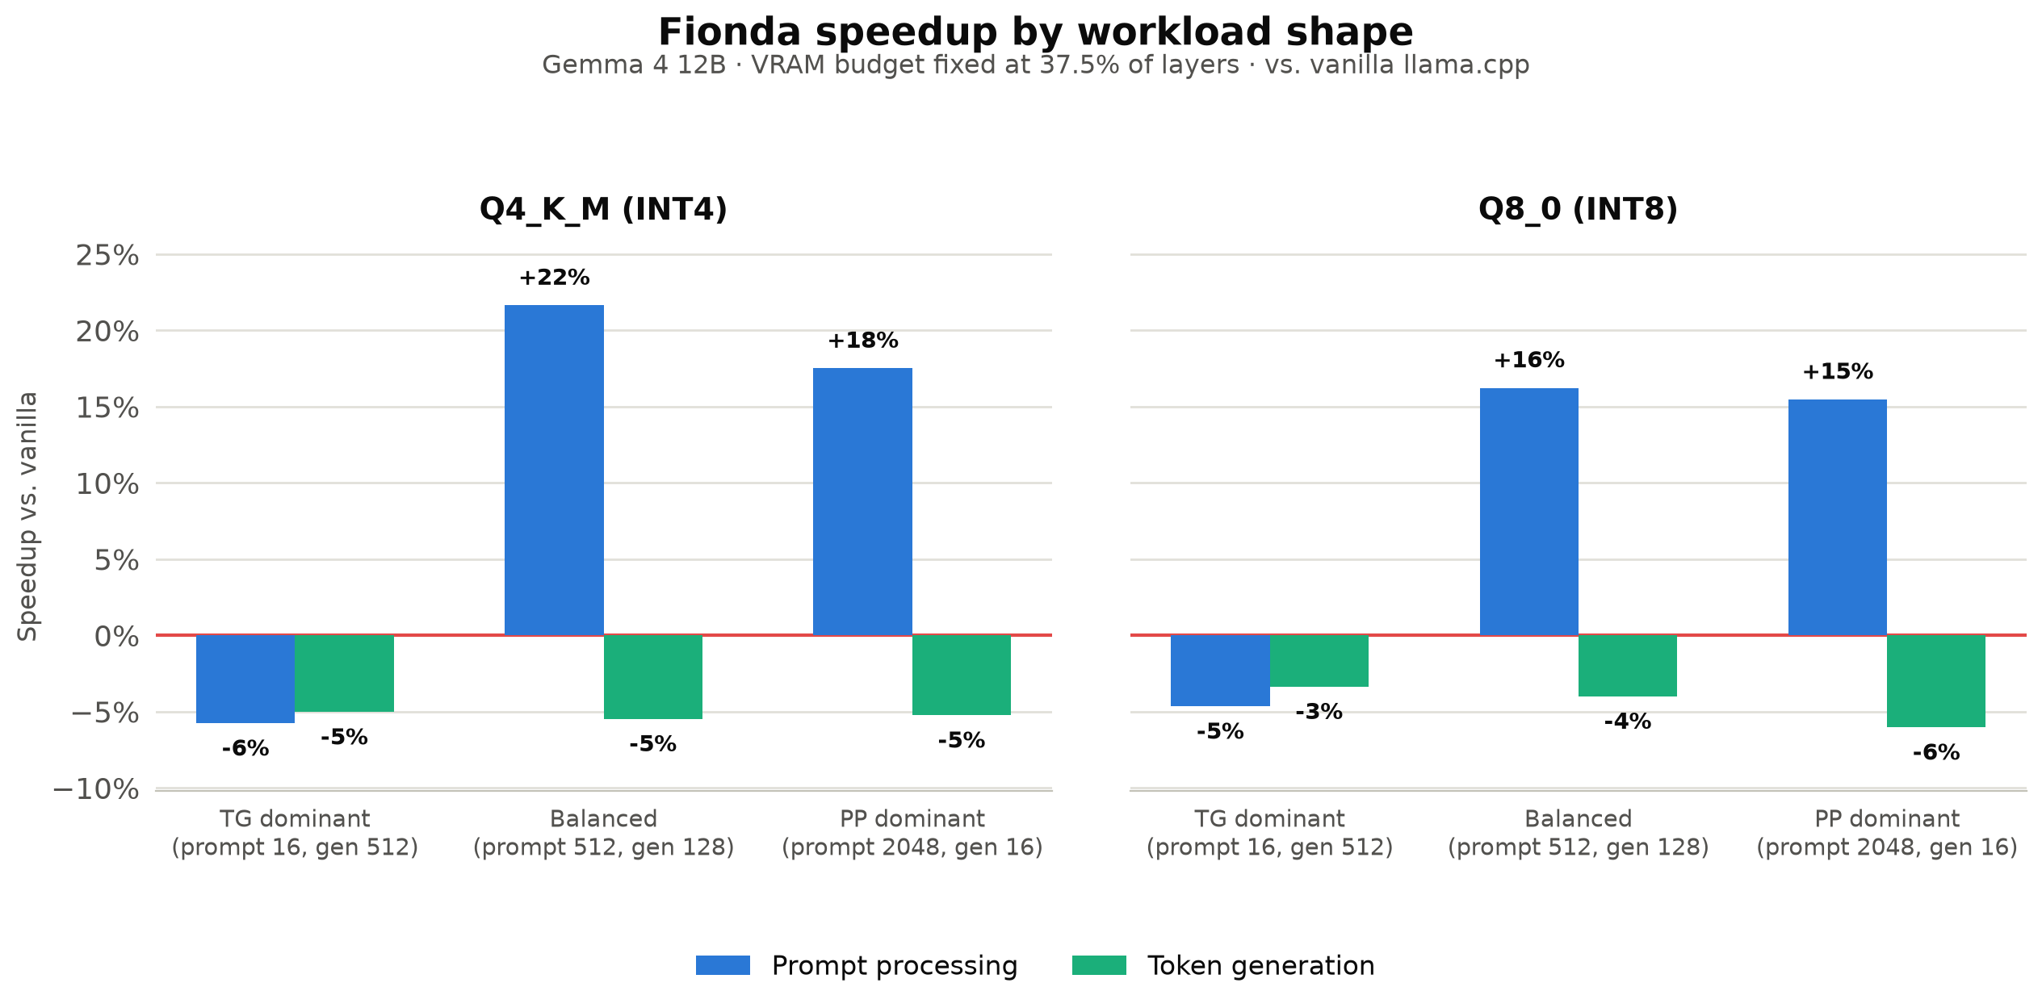
Gemma 4 prompt benchmark
22/07/2026
Santarsiero Andrea, Stanghellini Giovanni
06/11

Slide 8
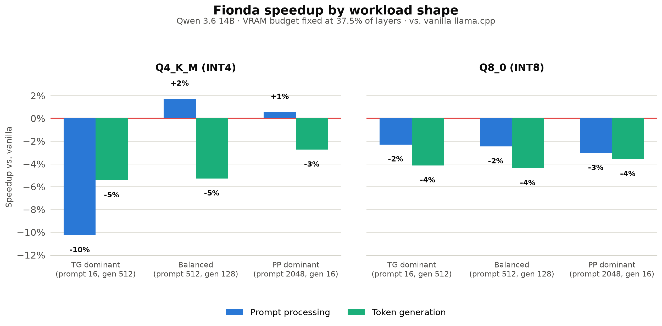
Qwen 3.6 prompt benchmark
22/07/2026
Santarsiero Andrea, Stanghellini Giovanni
07/11

Slide 9
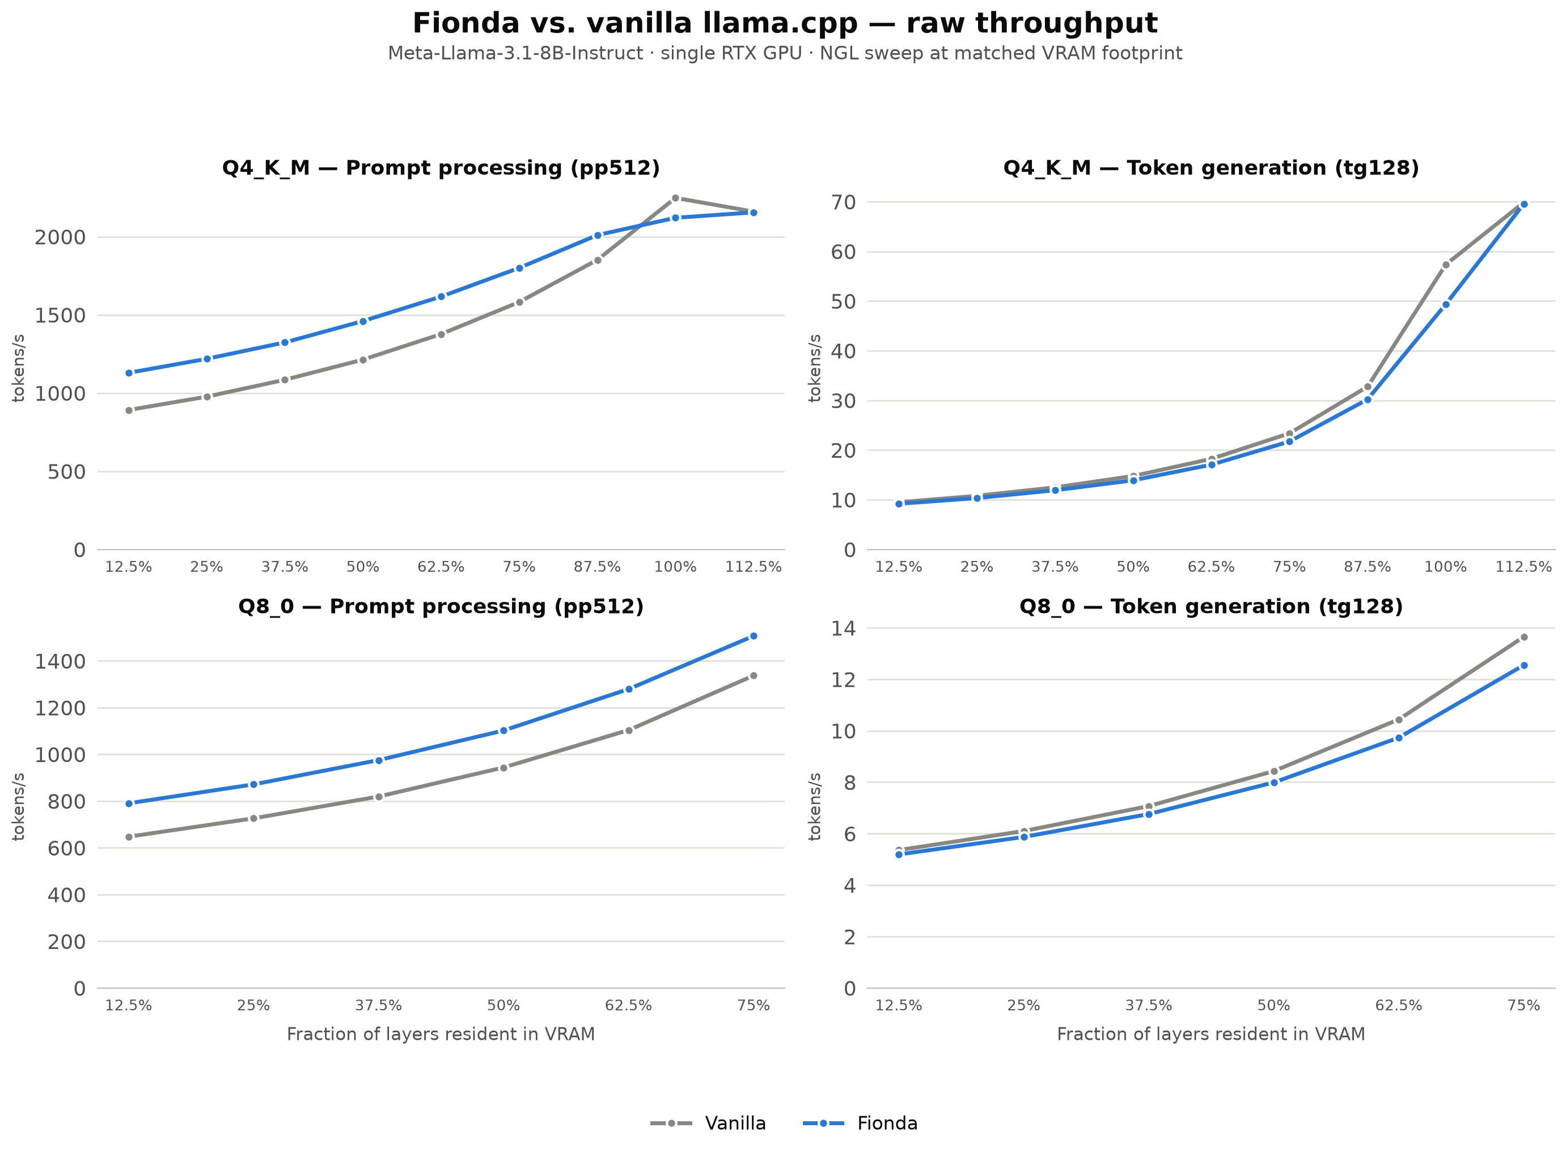
Llama 3.1 ngl benchmark
22/07/2026
Santarsiero Andrea, Stanghellini Giovanni
08/11

Slide 10
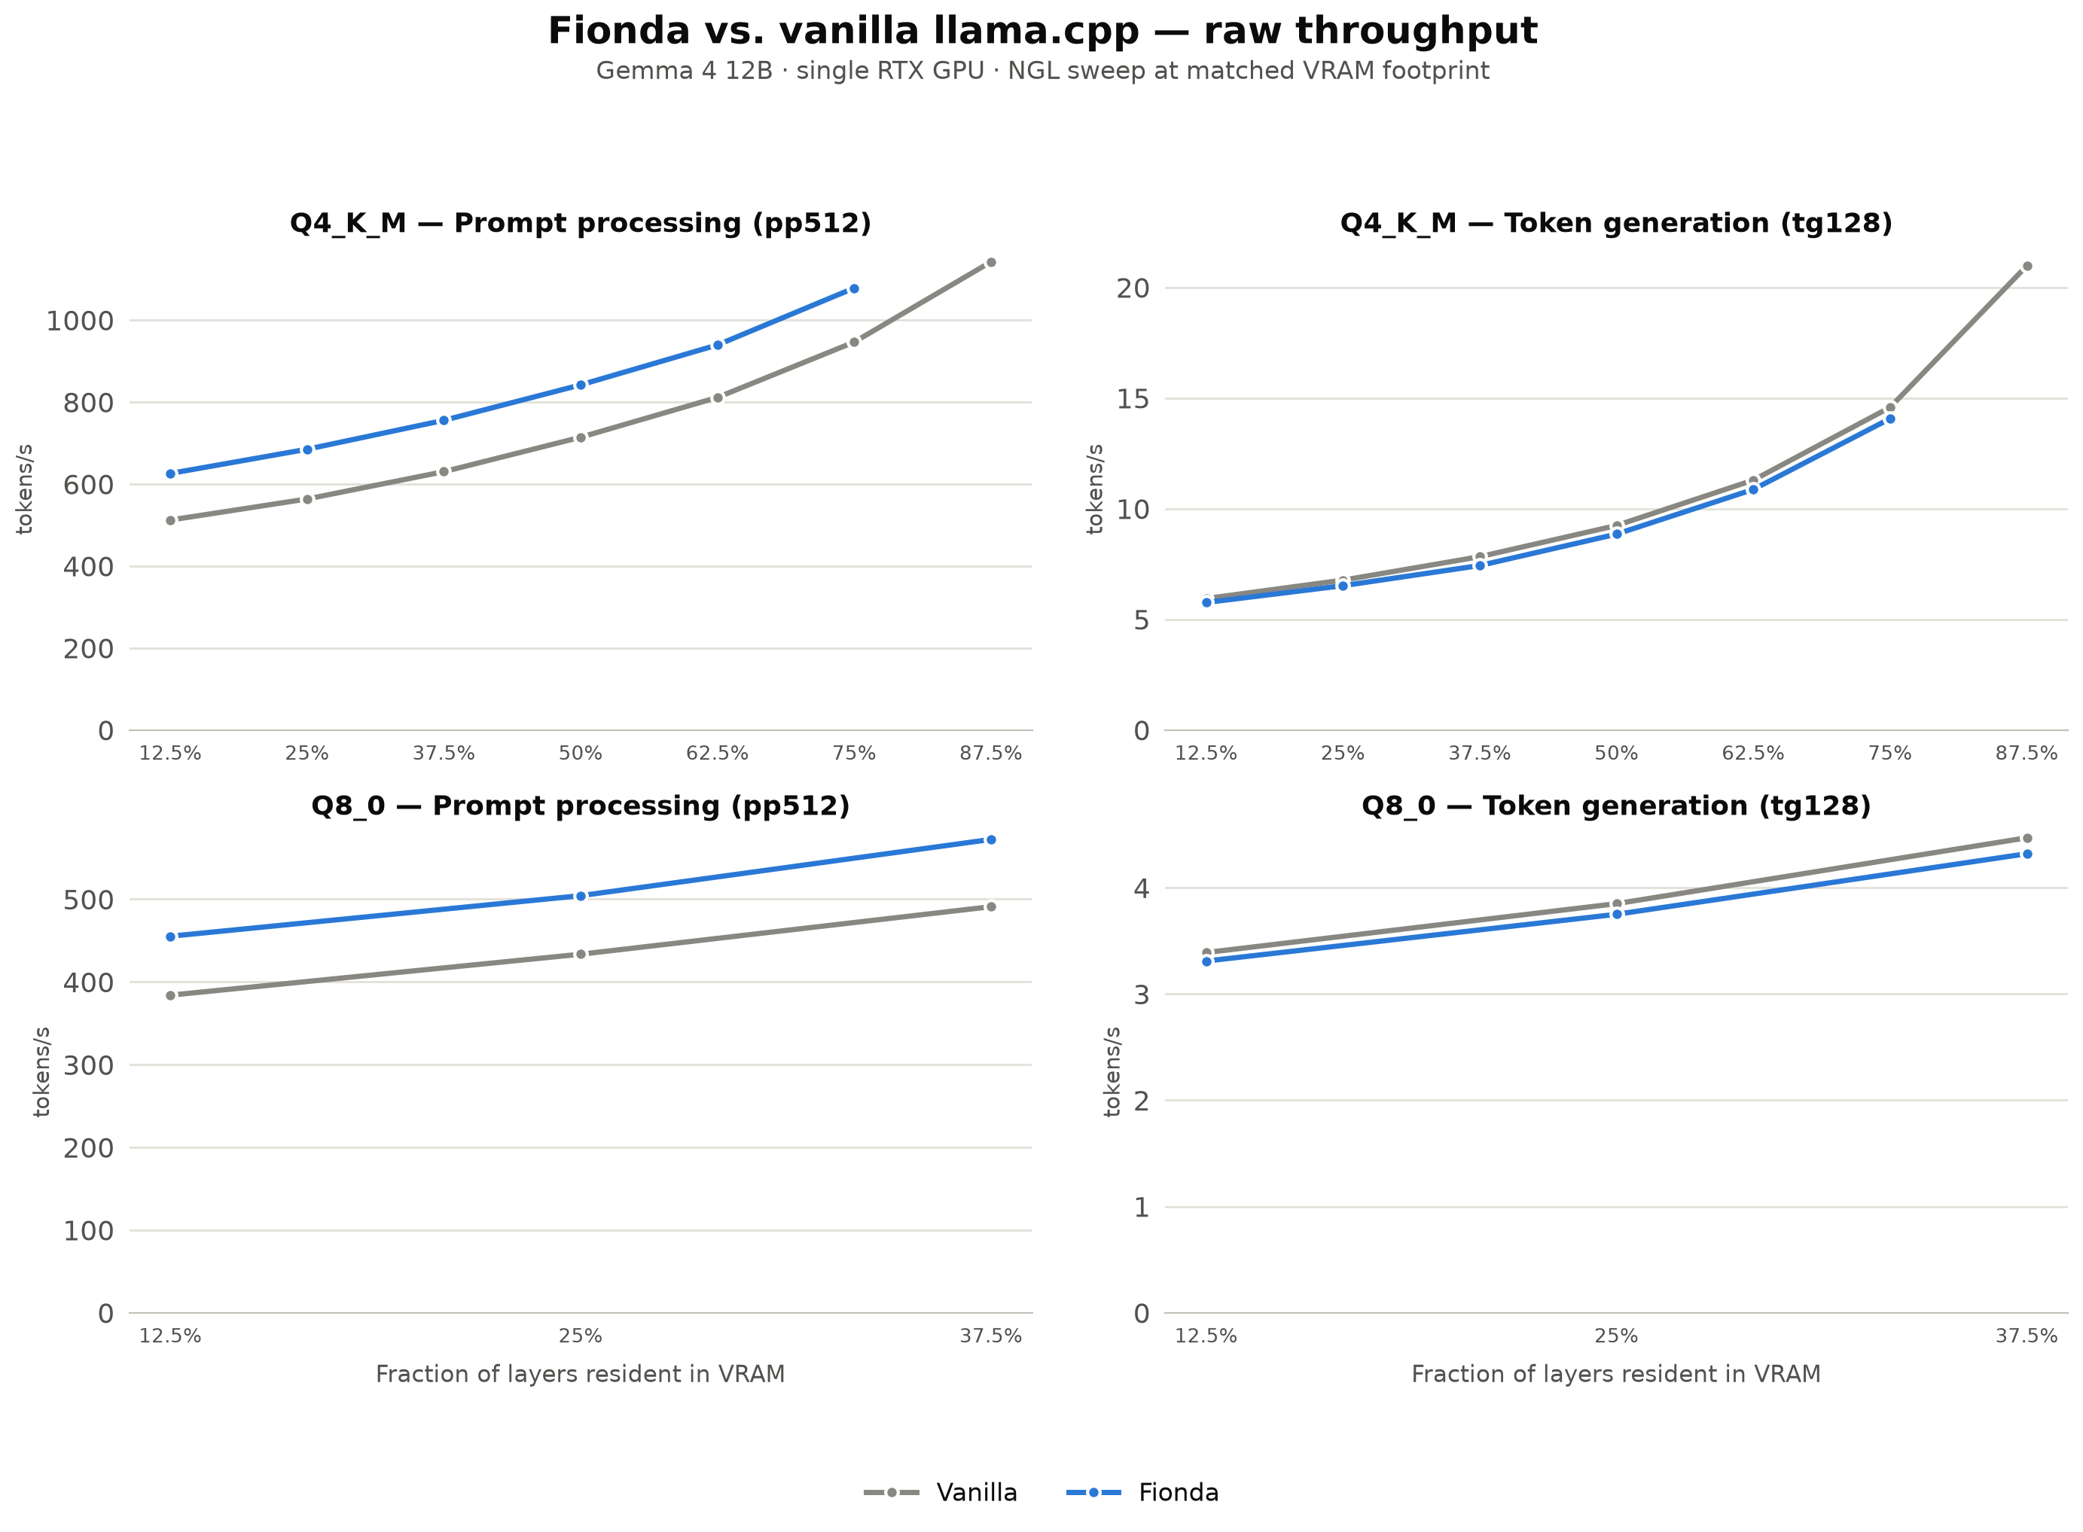
Gemma 4 ngl benchmark
22/07/2026
Santarsiero Andrea, Stanghellini Giovanni
09/11

Slide 11
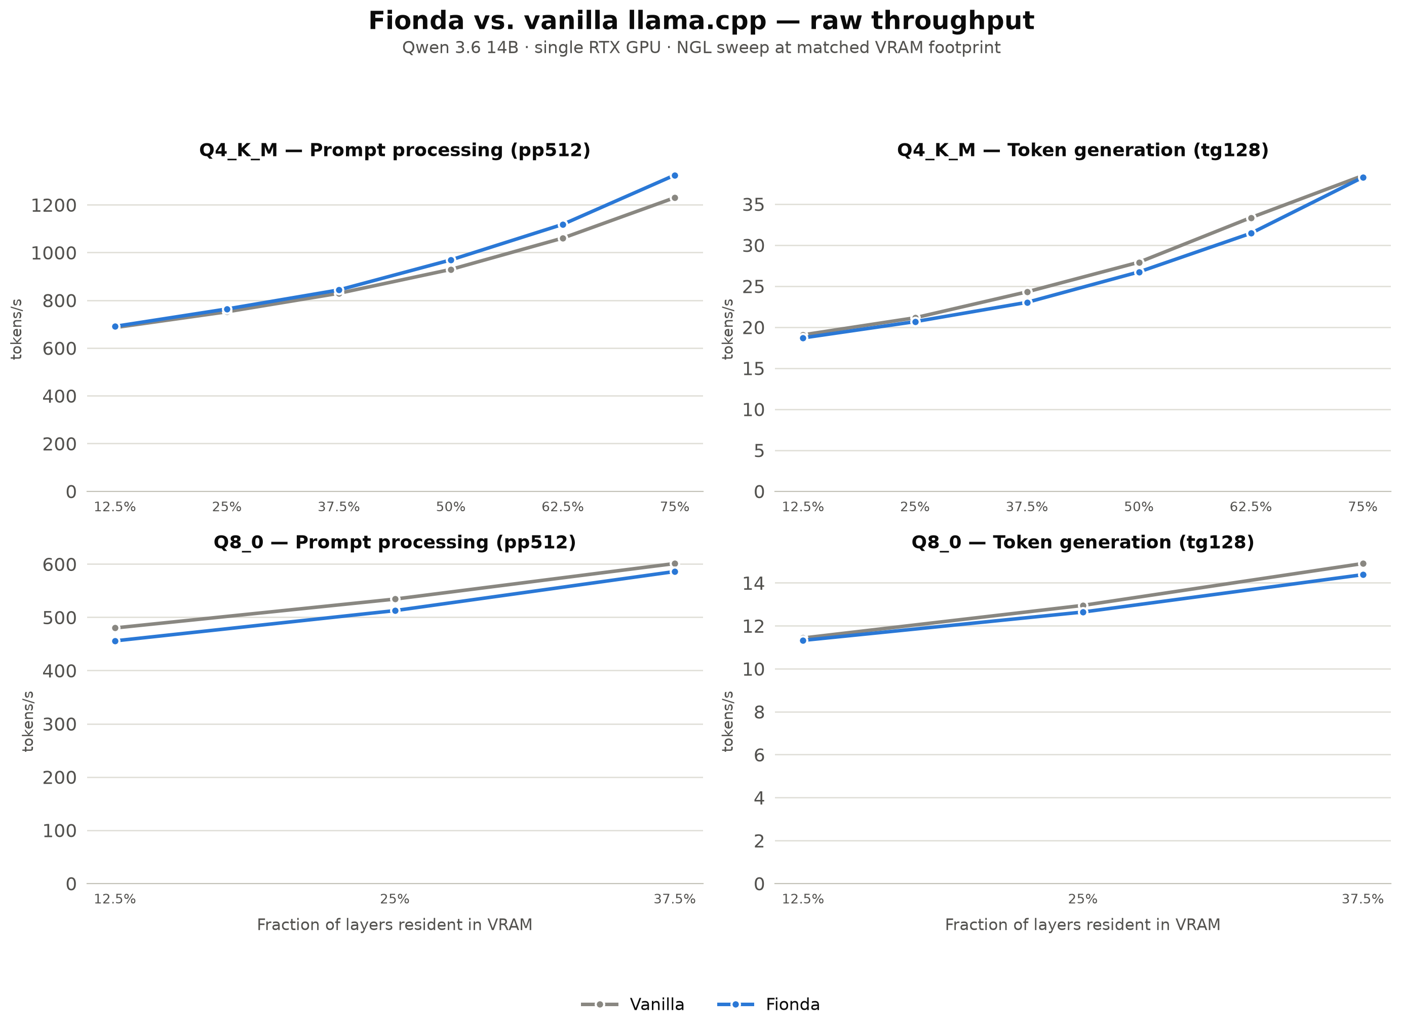
Qwen 3.6 ngl benchmark
22/07/2026
Santarsiero Andrea, Stanghellini Giovanni
10/11

Slide 12
What’s next?
Fionda scheduler allows us to speed-up the Prompt Processing phase while using the same amount of VRAM.
However, in a real-life scenario, the Token Generation phase is considered way more important since its speed is around 100 times lower than the PP phase.
That’s why we decided to trade-off part of the speed-up obtained in the PP phase to considerably improve the performances in the TG phase, making Fionda faster both in PP and TG compared to the Vanilla approach.
22/07/2026
Santarsiero Andrea, Stanghellini Giovanni
11/11

